Slide 1
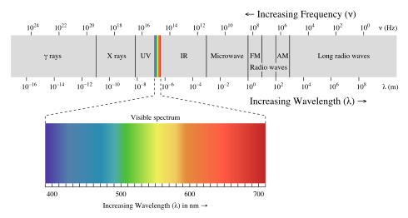
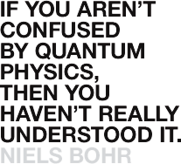
The Dual Nature of Light

Slide 2
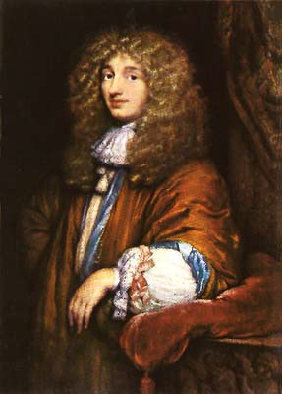
In the 1600s, Christiaan Huygens and Isaac Newton proposed competing theories for light's behavior.
Huygens proposed a wave theory of light in 1679 while Newton's was a "corpuscular" (particle) theory of light. Huygens' theory had some issues in matching observation.
According to Huygens :
Light must travel through a medium.
This medium is called Ether, which is an omnipresent, boundlessly resilient, massless medium and served as the medium that carried light waves.
Applying this theory, Huygens derived the laws of reflection and refraction.
Christiaan Huygens
(1629 – 1695)

Slide 3
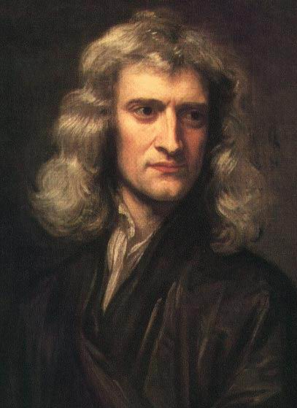
According to Newton’s theory: light is composed of particles (“corpuscular”) that travel in a straight line at an extreme speed, they allow the eye to experience vision when they are absorbed, and various coloured particles all have differing sizes.
Newton's prestige helped lend support to his theory, so for over a century his theory was dominant.
.
Sir Isaac Newton (1643 – 1727)

Slide 4
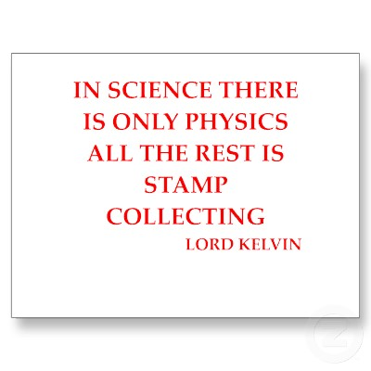



Slide 5


Slide 6

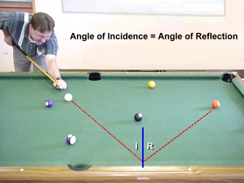
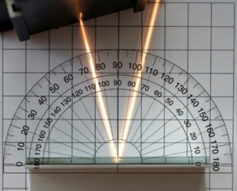
Reflection:- can be explained by treating light as a wave or a particle

Slide 7
Phenomenon | Can be explained in terms of WAVES | Can be explained in terms of PARTICLES
Reflection
Refraction
Diffraction
Interference
Polarization
Photo-Electric Effect

Slide 8
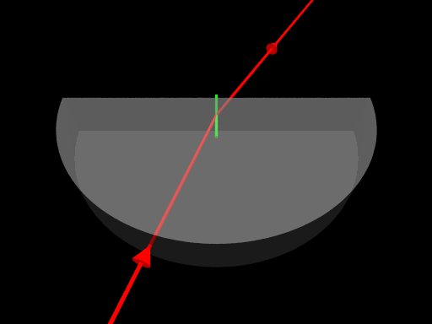
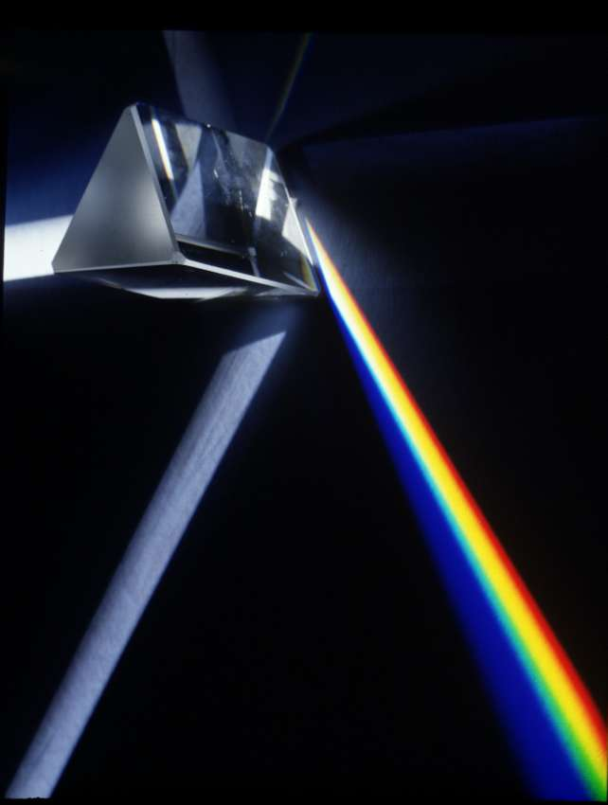
Refraction of light:- can be explained by treating light as wave or particle

Slide 9
Phenomenon | Can be explained in terms of WAVES | Can be explained in terms of PARTICLES
Reflection
Refraction
Diffraction
Interference
Polarization
Photo-Electric Effect

Slide 10
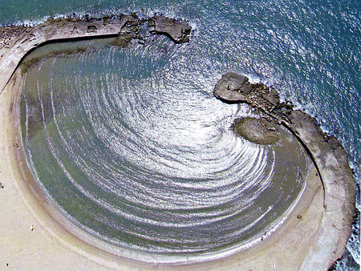
Diffraction:- We know diffraction occurs to water waves and even sound waves, but what about light?

Slide 11
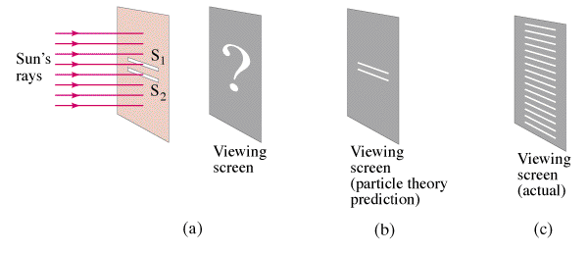
Young’s Double Slit Experiment
Thomas Young (1773-1829), an English scientist (also credited for helping translate the Rosetta Stone), conducted an experiment in 1801, known as Young's double-slit experiment, that allowed him to show the wave nature of light and measure its wavelengths.
The setup of this experiment is quite elegant:
Light from a single source shines through two narrow, closely-placed slits for them to serve as two coherent light sources. (A coherent light source is one that makes light waves have a consistent phase relationship with each other--crest overlaps crest, trough overlaps trough) A screen is put behind these slits.

Slide 12
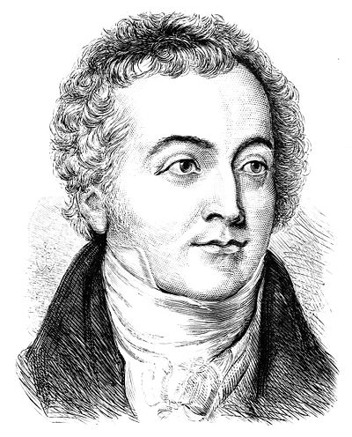
Young’s Double Slit Experiment
Now, if light consisted of particles, then the screen would reveal two bright lines when the light illuminated through.
Young, however, saw a centre bright line and groups of symmetrical dark and bright edges and explained these groups to be marks of constructive and destructive interference.

Slide 13
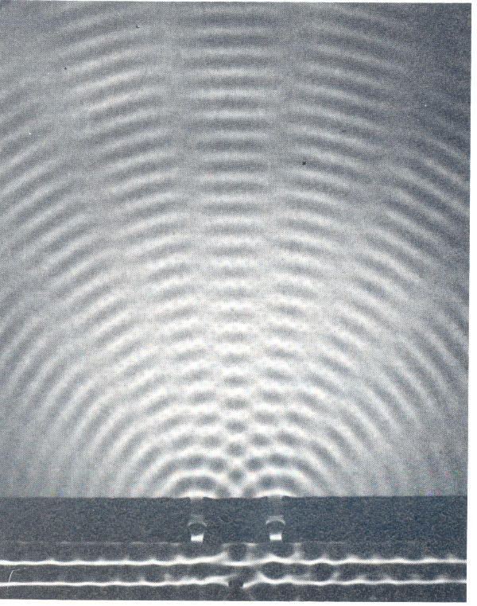
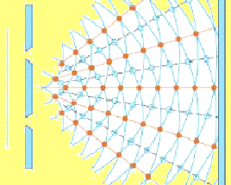
Light behaves like water waves in a ripple tank
min
max
min
max
min
max
Light must be a wave
min

Slide 14
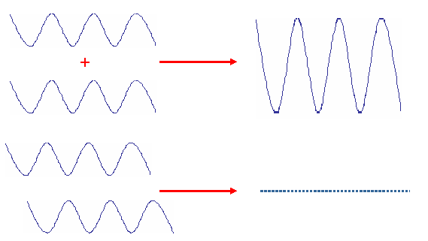
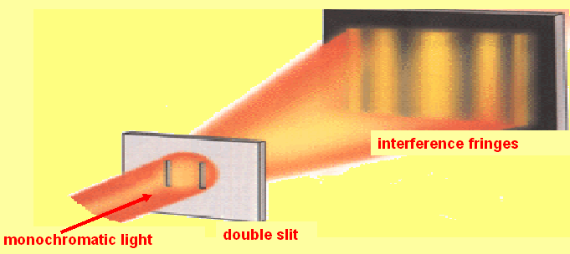
TOMAS YOUNG 1801 INTERFERENCE EXPERIMENT
constructive interference
destructive interference

Slide 15
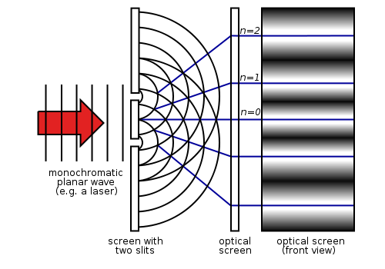
Young’s Double Slit

Slide 16

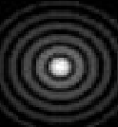
Light can be diffracted
circular aperture
Light must be a wave
light

Slide 17
Phenomenon | Can be explained in terms of WAVES | Can be explained in terms of PARTICLES
Reflection
Refraction
Diffraction
Interference
Polarization
Photo-Electric Effect
The Wave Theory takes the Lead!

Slide 18
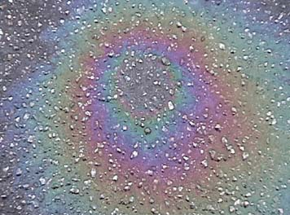
Interference:- it was possible to show two light sources produced constructive and destructive interference
this can be explained by the wave theory of light (treating light as a wave)

Slide 19
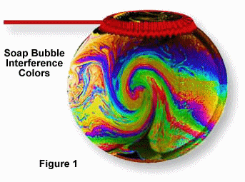
Interference of light:- can only be explained by treating light as a wave

Slide 20
Phenomenon | Can be explained in terms of WAVES | Can be explained in terms of PARTICLES
Reflection
Refraction
Diffraction
Interference
Polarization
Photo-Electric Effect
The particle theory is falling behind!

Slide 21
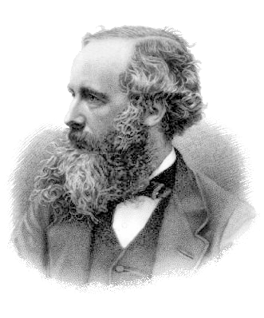
About 150 years ago, James Clerk Maxwell, an English scientist, developed a scientific theory to explain electromagnetic waves.
He noticed that electrical fields and magnetic fields can couple together to form electromagnetic waves. Neither an electrical field (like the static which forms when you rub your feet on a carpet), nor a magnetic field (like the one that holds a magnet onto your refrigerator) will go anywhere by themselves. But, Maxwell discovered that a CHANGING magnetic field will induce a CHANGING electric field and vice-versa. Unlike a STATIC field, a wave cannot exist unless it is moving.
Once created, an electromagnetic wave will continue on forever unless it is absorbed by matter.
Maxwell's equations were the building block for many future advances.

Slide 22
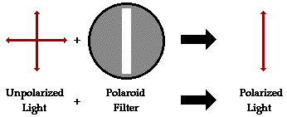
Polarized light waves are light waves in which the vibrations occur in a single plane. The process of transforming un-polarized light into polarized light is known as polarization.
Polarization could only be possible if Light acted like a WAVE

Slide 23
Phenomenon | Can be explained in terms of WAVES | Can be explained in terms of PARTICLES
Reflection
Refraction
Diffraction
Interference
Polarization
Photo-Electric Effect
The particle theory is falling further behind!

Slide 24
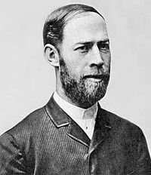
The Photo-Electric Effect:
The photoelectric effect was first observed in 1887 by Heinrich Hertz (1857-1894) during experiments with a spark-gap generator.
He noticed that the sparks he was producing were longer when the metal was exposed to ultra violet light. Although he didn’t investigate much more, his reported observations started a series of experiments by other scientists.

Slide 25
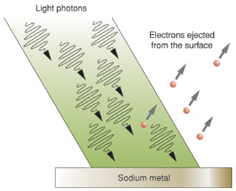
Photoelectric Effect:- Electrons were emitted from a surface when ultra violet light was shone on it.

Slide 26
The Photo-Electric Effect:
It was Philipp Lenard (1862-1947), an assistant of Hertz, who performed the earliest, definitive studies of the photoelectric effect. What Lenard found was that the intensity of the incident light had no effect on the maximum kinetic energy of the photoelectrons.
Those ejected from exposure to a very bright light had the same energy as those ejected from exposure to a very dim light of the same frequency. In keeping with the law of conservation of energy, however, more electrons were ejected by a bright source than a dim source.

Slide 27
The Photo-Electric Effect:
Later experiments by Robert Millikan (1865-1953), found that light with frequencies below a certain cut-off value, called the threshold frequency, would not eject photoelectrons from the metal surface no matter how bright the source. These result were completely unexpected.
Given that it is possible to move electrons with light and given that the energy in a beam of light is related to its intensity, classical physics (i.e Maxwells Wave theory) would predict that a more intense beam of light would eject electrons with greater energy than a less intense beam no matter what the frequency. This was not the case, however.

Slide 28
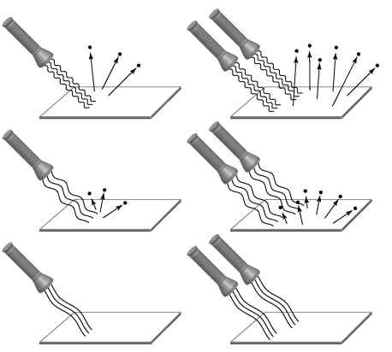
High frequency radiation emitted faster electrons. | Higher intensity did not increase speed of electrons. Number did increase.
Lower frequency radiation emitted slower electrons. | Higher intensity did not increase speed of electrons. Number did increase.
When the frequency was too low, no electrons were emitted. | Increasing intensity had no effect, no matter how high!

Slide 29
Phenomenon | Can be explained in terms of WAVES | Can be explained in terms of PARTICLES
Reflection
Refraction
Diffraction
Interference
Polarization
Photo-Electric Effect
WTF?? That threw a spanner into the works!!

Slide 30
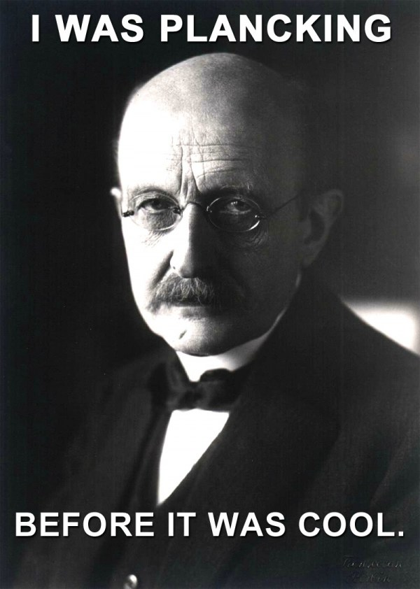
The Birth of Quantum Theory
The idea of light quanta was born with Max Planck's published his “Law of black-body radiation” in 1900, where he proposed what is now known as “The Planck postulate”. In this statement he argued that electromagnetic energy could be emitted only in quantized form.
In other words, the energy could only be a multiple of an elementary unit.
E = hf
where
E = Energy (J)
h = Planck's constant (6.62606957×10⁻³⁴ Js)
f = the frequency of the radiation. (Hz)

Slide 31
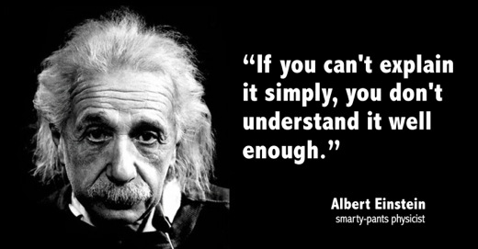
Quantum Theory explains the Photo Electric Effect
.
In 1905, Albert Einstein solved this apparent paradox of light behaving like a particle, by describing light as composed of discrete quanta, now called photons, rather than continuous waves. Based upon Max Planck's theory of black-body radiation, Einstein theorized that the energy in each quantum of light was equal to the frequency multiplied by a constant, later called Planck's constant.
A photon above a threshold frequency has the required energy to eject a single electron, creating the observed effect.
By assuming that light actually consisted of discrete energy packets, Einstein had explained why the energy of photoelectrons were dependent only on the frequency of the incident light and not on its intensity: a low-intensity, high-frequency source could supply a few high energy photons, whereas a high-intensity, low-frequency source would supply no photons of sufficient individual energy to dislodge any electrons.

Slide 32
Quantum Theory
Newton's theory - light consists of particles called corpuscles; this theory only explained reflection and refraction.
Wave theory of light (Maxwell's theory) - light behaves like a wave; this explained all the properties of light such as reflection, refraction, diffraction, interference and polarization; it did not explain the photoelectric effect or radiation produced by an incandescent light.
Quantum theory - light has a dual nature: when light is transmitted through space or matter, it behaves like a wave; when light is emitted or absorbed, it behaves like a particle called a photon.

Slide 33


PRE 1900 CLASSICAL THEORY
1900 PLANCK’S QUANTUM THEORY
ENERGY IS CONTINUOUS VARIABLE
AT THE ATOMIC LEVEL ENERGY IS QUANTISED, IT CANNOT HAVE ANY VALUE

Slide 34
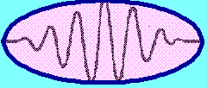

EINSTEIN (1905):
Light comes in packets of energy.
PHOTONS
E = h f
ENERGY OF A PHOTON is
but c = f λ

Slide 35
combining
and
i.e. the wavelength of a photon is Planck’s constant divided by its momentum, p .

Slide 36
1923 : Louis de Broglie : “If a photon behaves as particle with mass, then a particle should have an associated wavelength given by
where v is the particle’s velocity

Slide 37
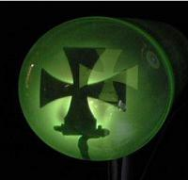
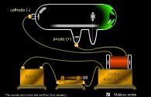
Behavior of Electrons
Particle behavior
cathode
anode

Slide 38

Electrons cast sharp shadows and are affected by magnetic and electric fields, unlike wave
Electrons must be Particles

Slide 39
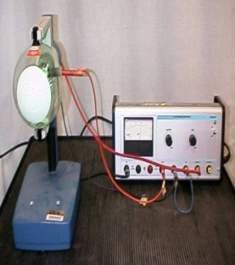

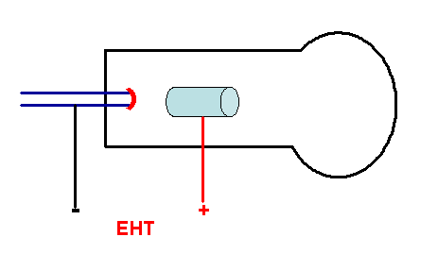
Wave Behaviour of electrons
Test: Can electrons be diffracted?
vacuum
heater
e
graphite target
YES, ELECTRONS DO HAVE A WAVE NATURE

Slide 40
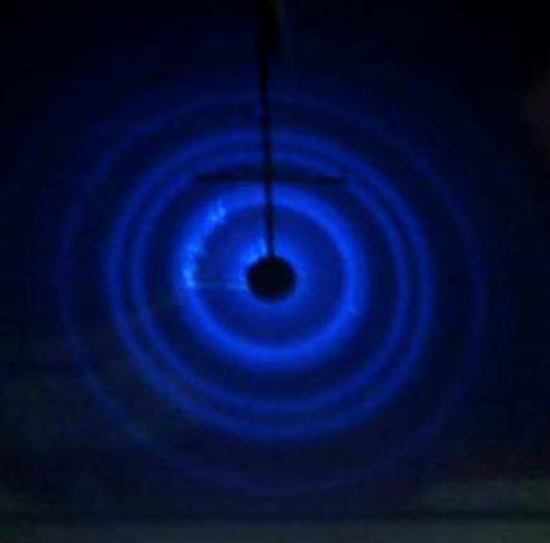
Electrons must be Wave-like
Electron diffraction can only be explained if electrons behave like waves

